Slide 1
Dental Health in Upstate N.Y.
Results from a 2018 community survey of upstate N.Y.

Slide 2
Background and Method
Univera Healthcare commissioned One Research to conduct an online survey of upstate New York adults. Participants were recruited from a vendor panel by email invitation to take the survey between February 2 and February 23, 2018. Participants were not asked to disclose their health care provider.
Survey respondents had to be at least 18 years old and living within the health plan’s 39-county coverage area. Data were weighted to census targets of age, sex, race and ethnicity. Findings in this report are based on the weighted data.
The design of the study was cross-sectional. The survey instrument contained a brief screening, demographic questions and randomized questions on several health-related topics, including dental health. The survey was designed for self- completion via an online platform. In conducting the analysis, data were tested at a 95 percent confidence interval.
Editor’s note: This is general population data, and not a survey of health plan members.

Slide 3
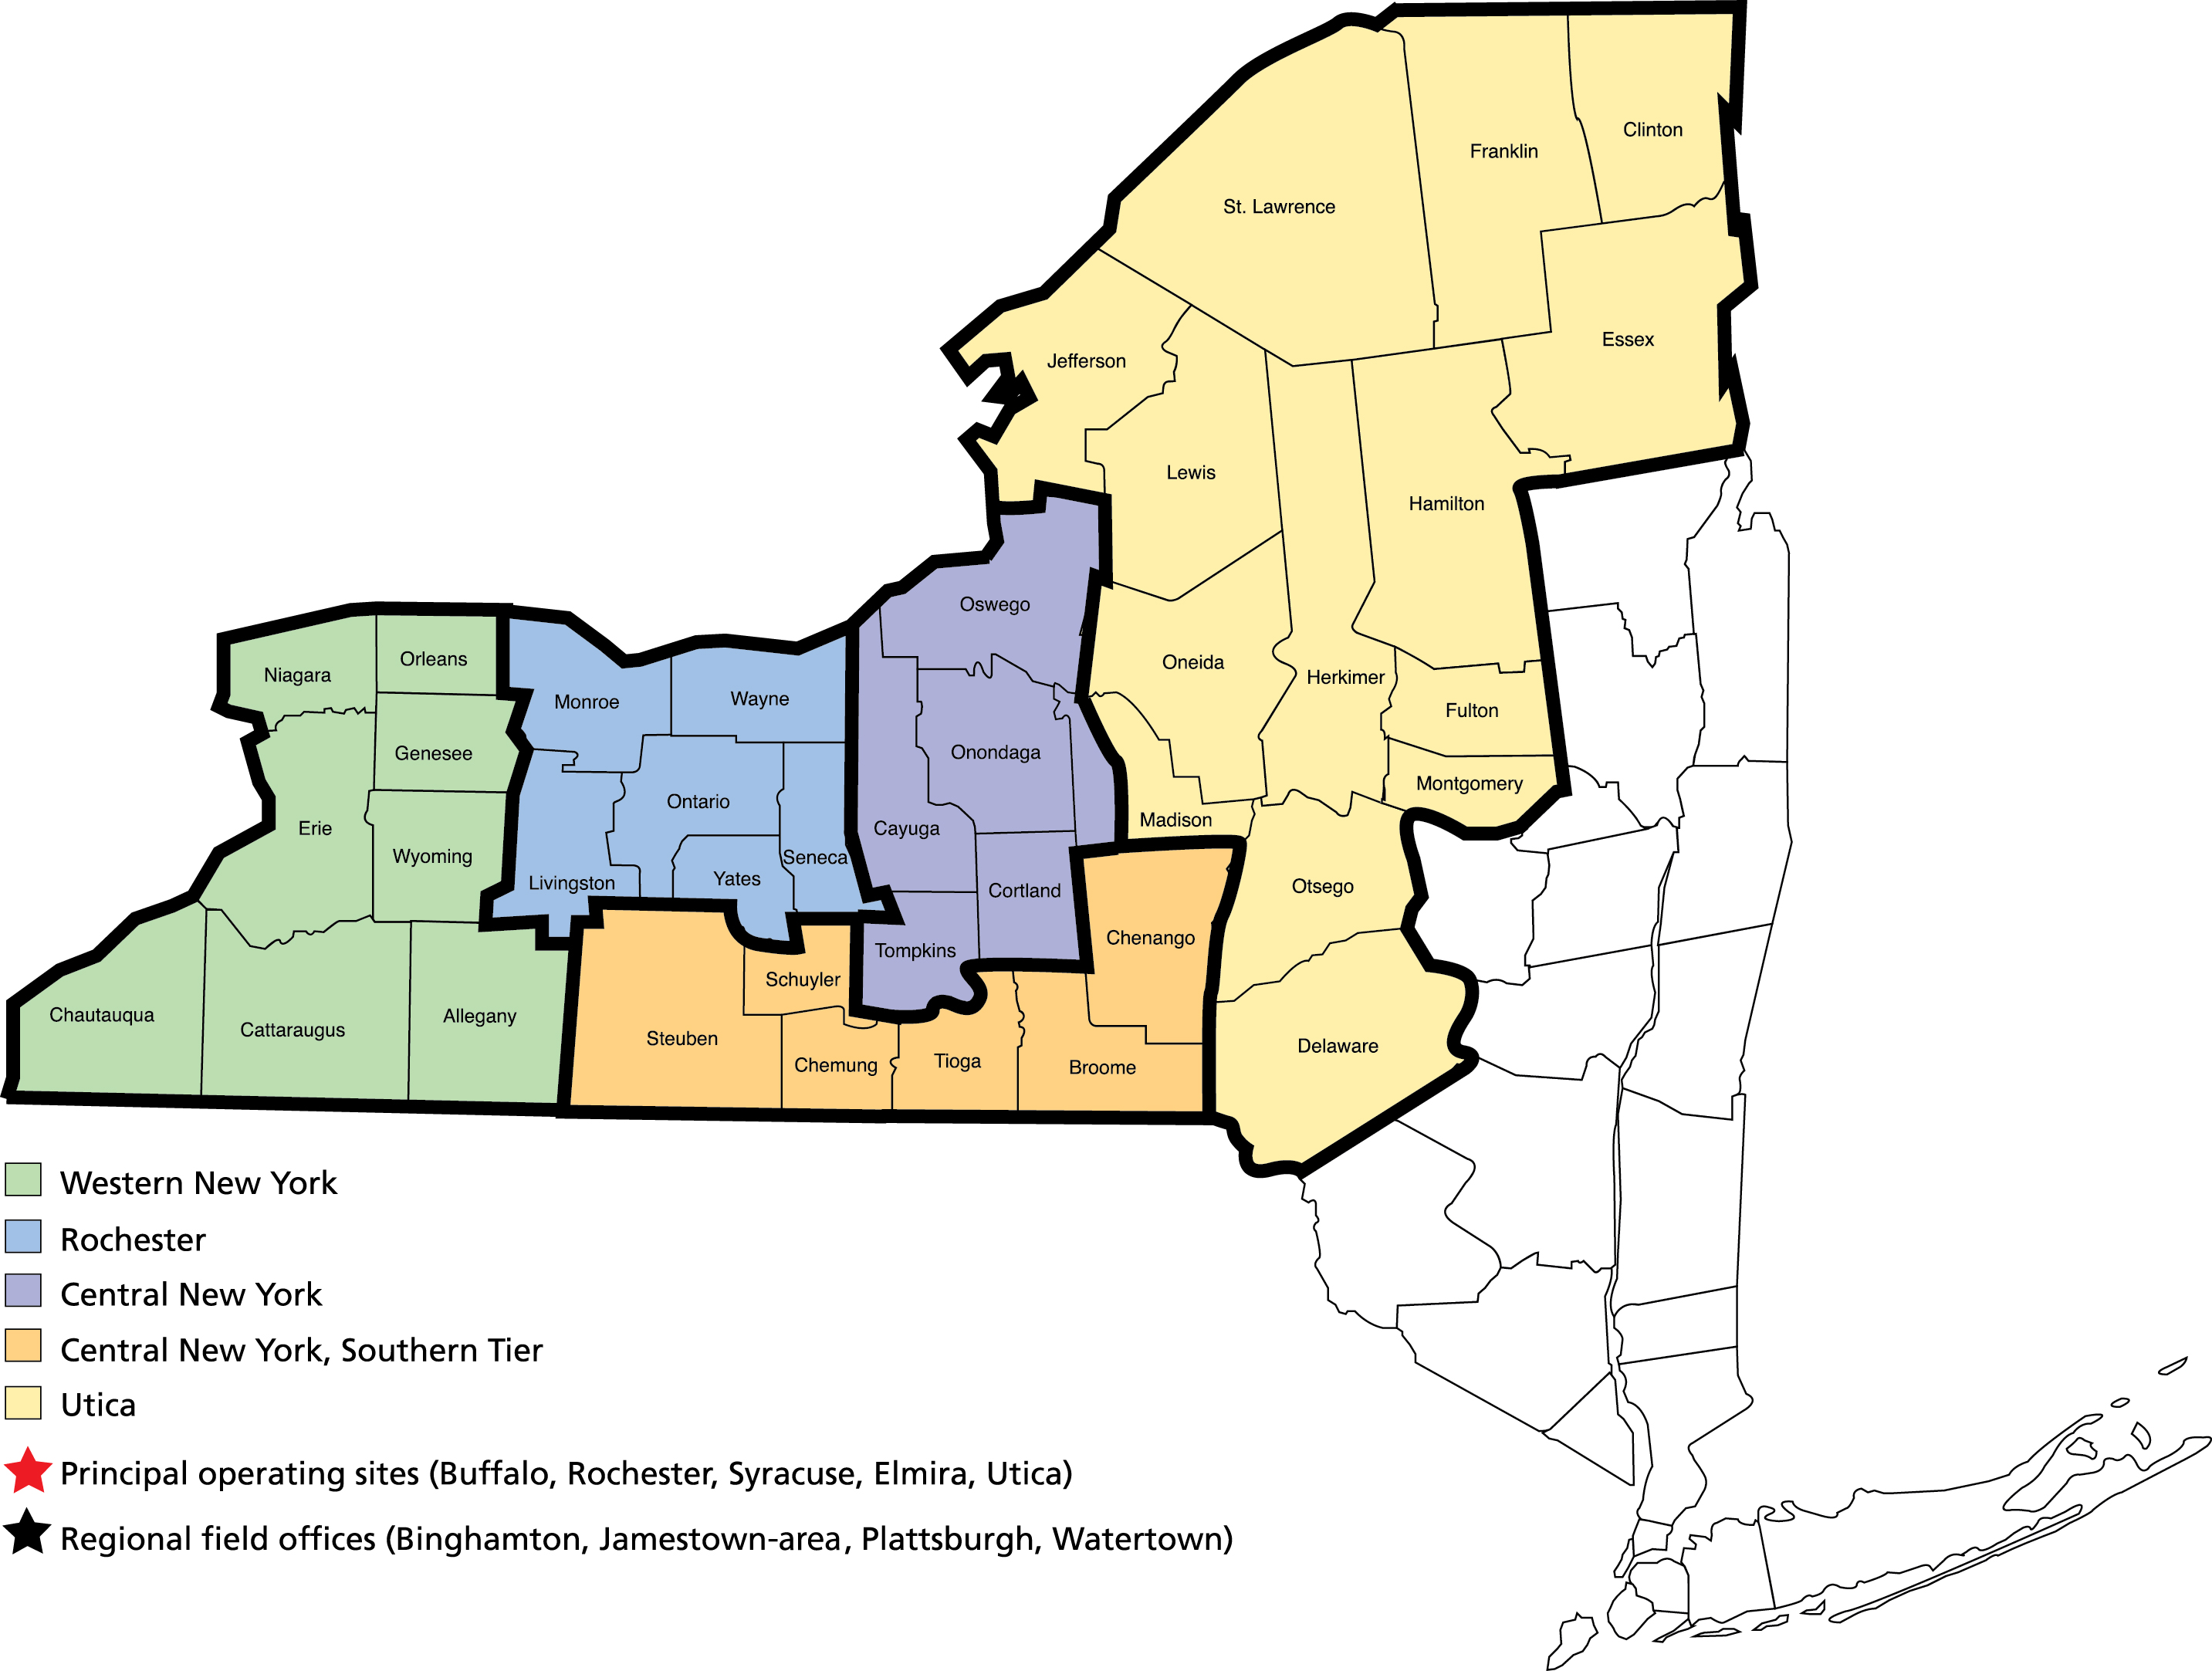
Participants
Regional demographics of participants
Western New York | 32%
Finger Lakes | 22%
Central New York | 17%
Central New York’s Southern Tier | 11%
Utica/Rome/North Country | 19%
2,000 individuals from a 39-county region in upstate New York completed the survey.
The demographics of the respondents indicate that the survey sample was representative of upstate New York adults.
Sex of participants
Male | 49%
Female | 51%
Age demographics of participants
18-24 | 12%
25-34 | 18%
35-44 | 18%
45-54 | 19%
55-64 | 16%
65+ | 17%

Slide 4
Participants (continued)
Race of participants
White | 92%
Black or African American | 4%
Native American or Alaskan Native | 1%
Mixed race | 1%
Some other race | 1%
Education level of participants
High school graduate or less | 23%
Some college | 23%
Associate’s degree | 15%
College 4 years | 24%
Post graduate | 16%
Employment status of participants
Employed full or part-time | 51%
Retired | 21%
Homemaker | 7%
Self-employed | 6%
Student | 5%
Not employed, looking for work | 4%
Not employed, not looking for work | 3%
Other | 3%
Annual household income of participants
Less than $15,000 | 9%
$15,000-$24,999 | 9%
$25,000-$34,999 | 11%
$35,000 to $49,999 | 14%
$50,000 to $74,999 | 19%
$75,000 to $99,999 | 14%
$100,000 or more | 16%
Prefer not to respond | 6%

Slide 5
Dental Health Results

Slide 6
Dental Health Summary
The majority of adults feel their dental health is good or very good. Nearly half have never lost a tooth to decay or gum disease.
Most people have a regular dentist, and one that is within their network.
Seventy percent of people say they see a dentist at least once per year, and half get their teeth cleaned two or more times in a 12-month period.
Among patients who do not receive the recommended number of cleanings, about one-third report that a cash incentive or gift card would motivate them to receive cleanings.

Slide 7
The majority of adults feel their dental health is good.
(n=2,000; all respondents)

Slide 8
Significantly more respondents from Utica/Rome/North Country reported poor dental health compared with those from the Finger Lakes and Western NY.

Slide 9
About half of adults have not had any permanent teeth removed.
(n=2,000; all respondents)

Slide 10
Most respondents report having a regular dentist.
Have a Regular Dentist
Do not
Total
(n=2,000; all respondents)

Slide 11
Significantly more respondents from Western NY and the Finger Lakes reported having a regular dentist compared with those from Utica/Rome/North Country.

Slide 12
Among respondents with a regular dentist, most have a dentist that is within their network.
Have a Regular Dentist
Do not
In Network
Not in Network
Don’t know
(n=1,492; only respondents who have a regular dentist)

Slide 13
Among those with a regular dentist, about 9 out of 10 respondents receive reminder notices for cleanings and appointments.
Have a Regular Dentist
Do not
In Network
Not in Network
Don’t know
Receive Reminder Notices re: cleanings & appointments
Do not
There are no significant regional differences in reminder notices
Whether dentist is in network does not impact likelihood of receiving reminders
(n=1,492; only respondents who have a regular dentist)

Slide 14
Seven out of ten people see a dentist at least once per year.
Less than 6 months ago
70%
6 months but less than 12 months ago
1 year but less than 2 years ago
2 years but less than 5 years ago
(n=2,000; all respondents)

Slide 15
Regional variation in time since last dental visit.

Slide 16
The top three reasons for not visiting a dentist were not having a tooth problem, not being able to afford care and fear.
Less than 6 months ago
70%
6 months but less than 12 months ago
1 year but less than 2 years ago
Top three reasons for not seeing a dentist at least twice in past year:
40% Have not had a tooth or mouth
problem in past 6 months
24% Could not afford / no insurance
16% Fear
2 years but less than 5 years ago
(n = 2,000; all respondents)
(n=906; only respondents who not seen a dentist in past 6 months)

Slide 17
All reasons for not visiting a dentist within the last 6 months
(n=906; only respondents who not seen a dentist in past 6 months)

Slide 18
Half of adults get a dental cleaning at least twice per year.
Percent of Respondents
(n=2,000; all respondents)

Slide 19
Respondents from Western NY, the Finger Lakes and Central NY are significantly more likely to report receiving 2 cleanings than respondents from Utica/Rome/North Country.

Slide 20
About one-third of respondents who do not receive two cleanings per year report that they would be motivated to get teeth cleaned with a cash incentive or gift card.
Percent of Respondents
Percent of respondents motivated by each
to get teeth cleaned regularly
32% A cash incentive or gift card
24% Nothing
17% A dentist closer to my home/work
16% A dentist in my network
12% Other [Comments primarily focus on “better affordability”]
14% Don’t know / Unsure
‘Select all that apply’ response, therefore sums to more than 100%
(n=2,000; all respondents)
(n = 879; only respondents who had teeth cleaned less than twice per year)

